Slide 1


SunGard Futures Systems
J2EE Architecture Overview
June, 2004

Slide 2
J2EE Architecture
Java 2 platform, Enterprise Edition (J2EE) is a comprehensive set of
specifications for designing, developing, and deploying multitier, server-
based applications.
The J2EE specifications are the result of an industry-wide effort that
involves a large number of contributors.
The standard architecture defined by the J2EE specification is composed of the
following elements:
  Standard application model for developing multitier applications.
  Standard platform for hosting applications.
  Compatibility test suite for verifying that J2EE products comply with the
  J2EE specification.
  Reference implementation providing an operational definition of J2EE.

Slide 3
Enterprise Distributed Architecture
Internet
Enterprise Intranet
Database Servers
JDBC
Oracle
JDBC
DB2
Flat Files
Name Servers
Web
Browser
Novell
LDAP
DNS
HTTP
JNDI
JNDI
Java
Client
Servlet
EJB Bean
RMI
Java Distributed Objects
Web
Browser
Web
Server
EJB-enabled Application Server
RMI
Servlet
Java
Client
HTTP
RMI
RMI
Web
Browser
Servlet
RMI
HTTP
EJB Bean
Java
Client
Legacy Objects
Corba
Corba
Other Enterprise Services
JMS
Message Service
JMS
JTA
Transaction Service
JTA

Slide 4
J2EE Benefits
Some benefits of deploying to a J2EE compliant architecture include:
  A simplified architecture based on standard components, services, and clients, that takes advantage of the write-once, run-anywhere Java technology.
  Services providing integration with existing systems, including Java DataBase Connectivity (JDBC); Java Message Service (JMS); Java Interface Definition Language (Java IDL); the JavaMail API; and Java Transaction APIs (JTA and JTS) for reliable business transactions.
  Scalability to meet demand, by distributing containers across multiple systems and using database connection pooling, for example.
  A wide selection of application development tools and components from vendors providing standard solutions.
  A flexible security model that provides support for integration with legacy security schemes and a unified approach to securing application components.

Slide 5
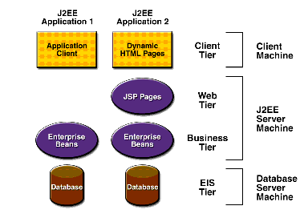
J2EE Multi-Tier Architecture
The J2EE platform uses a distributed multitiered application model for enterprise applications. Application logic is divided into components according to function, and the various application components that make up a J2EE application are installed on different machines depending on the tier in the multitiered J2EE environment to which the application component belongs.

Slide 6
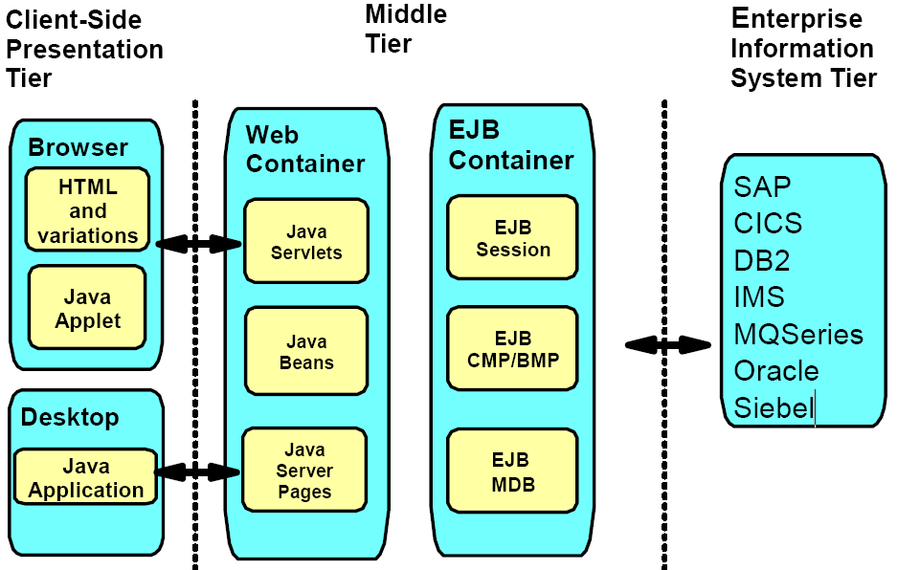
J2EE Multi-Tier Components

Slide 7
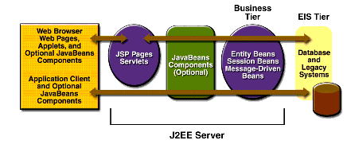
J2EE Server Tiers

Slide 8
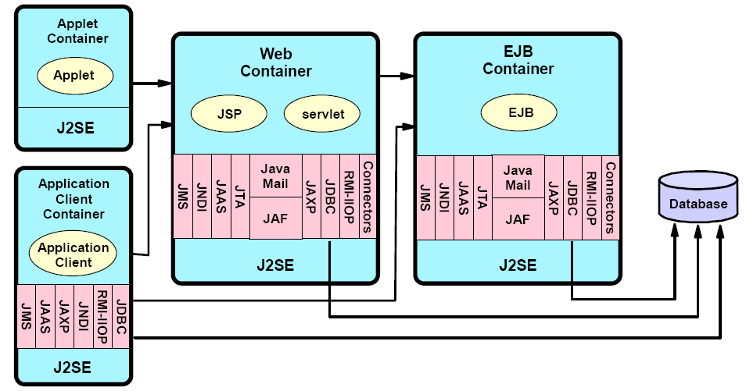
J2EE Containers
Containers are the interface between a component and the low-level platform-specific functionality that supports the component. Before a Web, enterprise bean, or application client component can be executed, it must be assembled into a J2EE application and deployed into its container.

Slide 9
J2EE Services, Part 1
Service | Description
Naming | Because J2EE applications are distributed, they need a way to look up and access remote objects and resources, such as EJBs and data sources. This is supported via the Java Naming and Directory Interface (JNDI).
Data access | J2EE supports both declarative and programmatic data access. It provides the Java Database Connectivity API (JDBC) for connectivity with relational database systems. It provides the Connector architecture (resource adapters) to give applications uniform access to various kinds of enterprise information systems.
Transaction | J2EE supports both declarative and programmatic transactions. It provides the Java Transaction API (JTA) to handle transaction processing.
Security | J2EE supports both declarative and programmatic security. It provides the Java Authentication and Authorization Service (JAAS) to authenticate and enforce access controls upon users.

Slide 10
J2EE Services, Part 2
Service | Description
Messaging | J2EE provides JavaMail and the Java Messaging Service (JMS) to asynchronously send and receive messages. JavaMail is for e-mail messages. JMS is for program-to-program messages.
Communication | J2EE supports the following protocols: Internet protocols—These include TCP/IP, HTTP 1.0 and SSL 3.0 RMI protocols—Remote Method Invocation is a set of APIs used by Java distributed applications, including EJBs. OMG protocols—Object Management Group protocols allow J2EE application to communication with remote CORBA objects. .

Slide 11
J2EE Roles
J2EE also defines a number of distinct roles performed during the application development and deployment life cycle:
Product provider—Designs and offers the J2EE platform, APIs, and other features defined in the J2EE specification for purchase.
Tool provider—Provides tools used for the development and packaging of application components.
Application component provider—Creates Web components, enterprise beans, applets, or application clients to use in J2EE applications.
Application assembler—Takes a set of components developed by component providers and assembles them in the form of an enterprise archive (EAR) file.
Deployer—Is responsible for deploying an enterprise application into a specific operational environment.
System administrator—Is responsible for the operational environment in which the application runs.

Slide 12
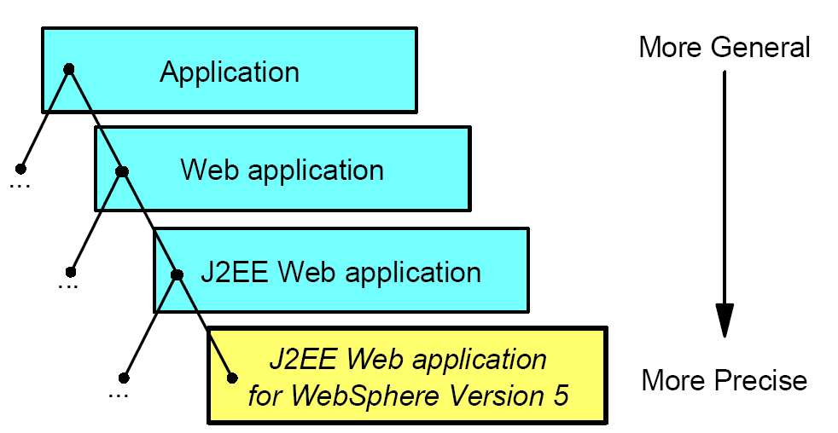
Application Types

Slide 13
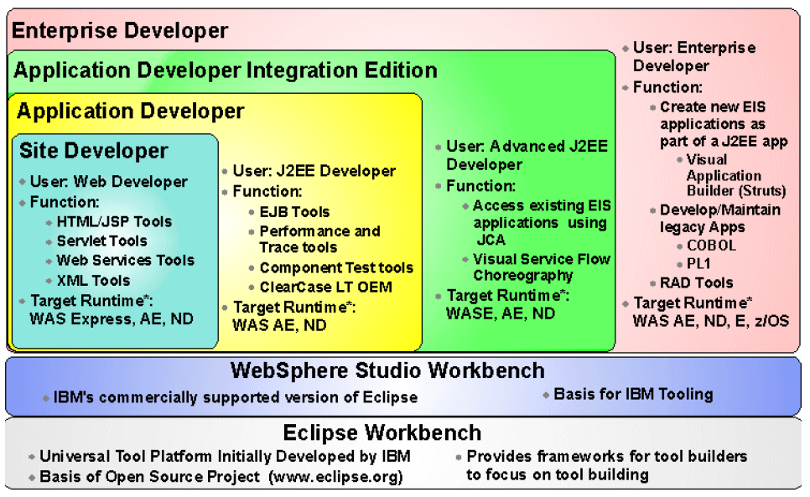
WebSphere Studio Family

Slide 14
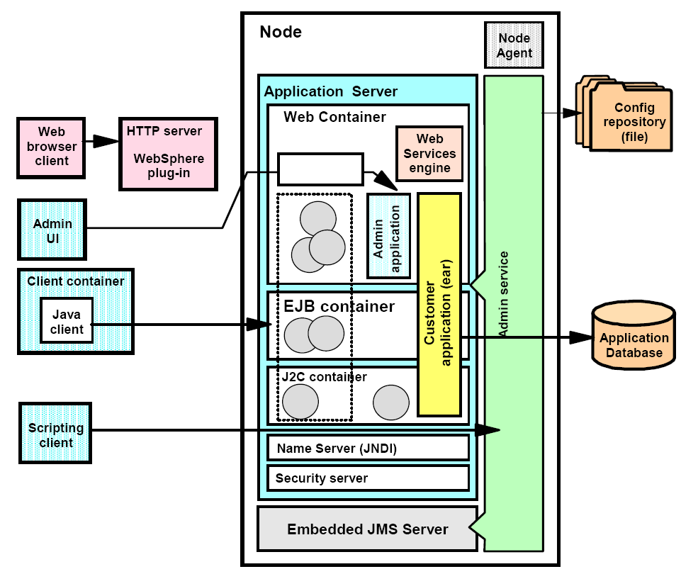
WebSphere Application Server Architecture

Slide 15
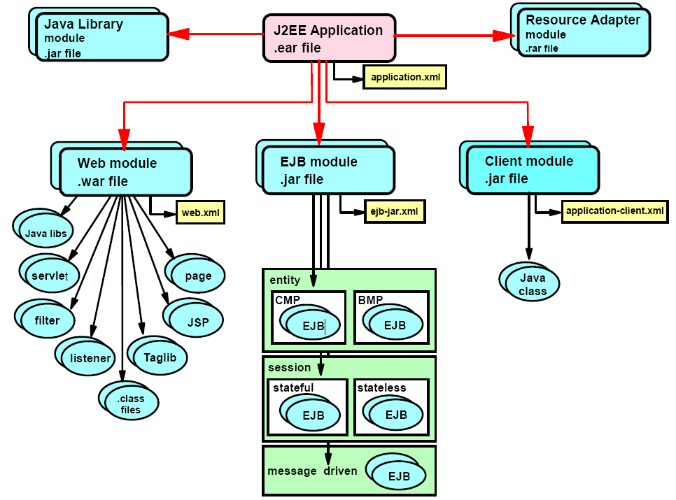
J2EE Packaging

Slide 16
EAR File
An EAR file is composed of any number of the following components:
EJB modules —An EJB module contained in an EJB JAR file contains one or more EJBs.
Web modules —A Web module contained in a Web application WAR file contains a single Web application. As an EAR file can contain multiple Web applications, each Web application in an EAR file must have a unique deployment context.
Application client modules —An application client module contained in a client JAR file contains a single, standalone Java application that is intended to run within an application client container. The application client JAR file contains a specialized deployment descriptor and is composed similarly to the way an EJB JAR file is composed. The JAR file contains the classes required to run the standalone client, in addition to any client libraries needed to access JDBC, JMS, JAXP, JAAS, or an EJB client.
Resource adapter modules —A resource adapter module contained in an RAR file contains Java classes and native libraries required to implement a Java Connector Architecture (JCA) resource adapter to an enterprise information system. Resource adapters do not execute within a container. Rather, they are designed to execute as a bridge between an Application Server and an external enterprise information system.

Slide 17
J2EE Build Architecture
Structure
EAR
Enterprise Archive
WAR
Web Archive
JAR
Java Archive
Common Components (Security)
3rd Party (eg CocoBase)
EJB
Session Beans
Entity Beans
Business Components
Applet
JSP
Servlets
Business Components
Sequence
1. JARs
2. WAR
3. EAR

Slide 18
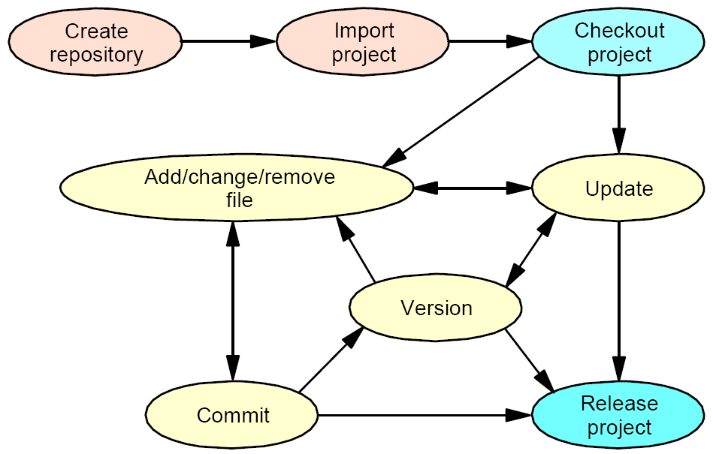
CVS Lifecycle

Slide 19
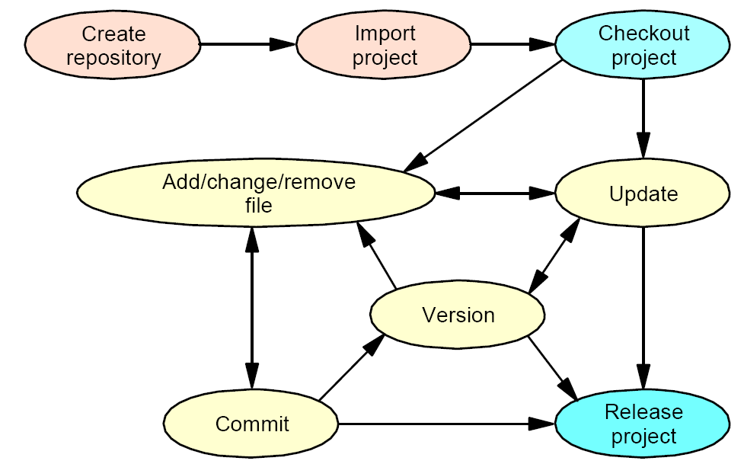
Clear Case Lifecycle

Slide 20
Development/Deployment Process
WSAD
WebSphere Application Development
Version Manager
WAS
WebSphere Application Server
Development Process
Version Process
Deploy/Release Test Process
1. Check-In
2. Check-Out/
Synchronize in WSAD
3. Deploy -FTP to WAS
1. Deploy via Admin Console
2. Test Release
3. Promote /Fix
Test/Code
1. Test Script - Unit
a. System or Business
2. Code/Build JARs/WAR
3. Test Code
4. Test Script - Integration
5. Test Integration
Build Release
6. Build EAR
Build Program
1. Use ANT or OpenMake
2. Identify Targets/Dependencies
3. Build/Standardize

